Slide 1
STUDENT INFORMATION MANAGEMENT SYSTEM
PRESENTED BY:
SUHA SHAHID(003)
MOHAMMAD SOBAN(010)
MUHAMMAD SAAD KHAN(086)

Slide 2

INTRODUCTION
This project is about student information management system. It uses C++ language and works and on various software like visual studio. The system used various functions and structures and stores data in text files.

Slide 3

Objectives:
The major objectives of this project are:
To create a simple menu for student/teacher
To let students view their saved details
To let teachers add, update, delete or search specific student’s details.
To store student information safely in the text files for easy accessibility.

Slide 4
INPUTS:
User can choose between student and teacher from the menu to use required option.
User if chooses student then can view each student’s personal details by just searching for the id.
User if chooses teacher option then gets welcomed by various options.
User can then choose between adding, viewing, updating, searching and deleting student information.
User can specifically search for any student by just typing their id.

Slide 5
Outputs:
A menu for the user.
Options for the user to choose between student and teacher.
Student details when specific student id is searched.
Various options to insert, delete, view, update or search when teacher’s option is chosen.
Let user either pick between adding details or adding marks.
Enter all the required student details when asked.
Enter all the required marks details when asked.
Save the date and show it in separate text file.

Slide 6
Algorithm
Ask user to choice to view student aur teacher details.
If user presses 1, ask them to view student details or marks.
If user presses 2, show them 6 teacher related options.
Show user to either insert details/marks, delete details/marks, update details/marks, search details/marks, view details/marks.
Ask user to enter 1 or 2 to make changes to details or marks respectively.
End task by pressing 6.

Slide 7
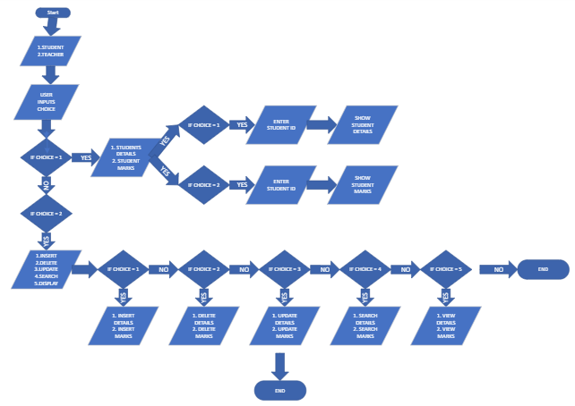
FLOWCHART

Slide 8



CONCLUSION
Through this system, we were able to:
Make a easy to use menu
Let student view their details and marks
Let teacher add student details and make changes accordingly.
Easily save all the data in text files to keep the records protected.

Slide 9




Thank you

